Slide 1
SUPPORT VECTOR MACHINES
Notes:
‹#›

Slide 2
Hyperplane
Hyperplane is the decision boundary that is used to separate the data points of different classes in a feature space.
The goal of an SVM is to create a flat boundary called as Hyperplane, which divides the space to create fairly homogeneous partitions on either side.
SVMs can be used for any type of learning task such as classification and numeric prediction.
A discriminative classifier - Non-parametric, Inductive.

Slide 3
Hyperplane
SVM is inspired from statistical learning theory.
SVM became popular because of its success in handwritten digit recognition.
Has been one of the go-to methods in machine learning since the mid-1990s (only recently displaced to some extent by deep learning)
Other names: Large-margin classifier, Max-margin classifier, Kernel methods

Slide 4
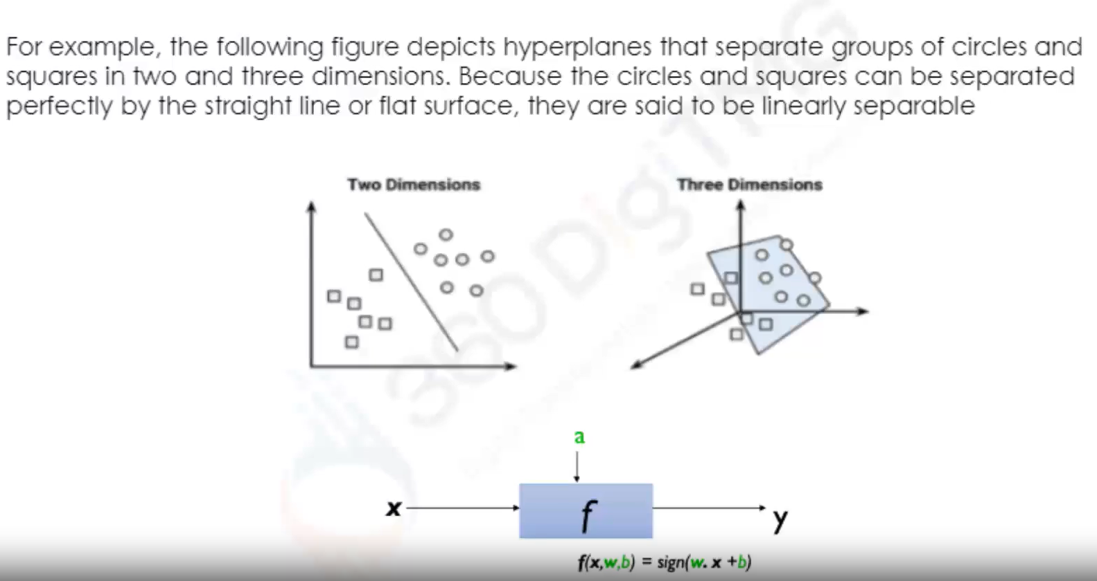
Classification with Hyperplanes

Slide 5
Perceptron Revisited: Linear Separators
Binary classification can be viewed as the task of separating classes in feature space:
w^{T}x + b = 0
w^{T}x + b > 0
w^{T}x + b < 0
f(x) = sign(w^{T}x + b)
Notes:
‹#›

Slide 6
Linear Separators
Which of the linear separators is optimal?
Notes:
‹#›

Slide 7
The Best Fit
In two dimensions, the task of the SVM algorithm is to identify a line that separates the two classes.
As shown in the following figure, there is more than one choice of dividing line between the groups of circles and squares. How does the algorithm choose
SVM searches for Maximum Margin Hyperplane (MMH)
MMH is as far away as possible from outer boundaries (convex hull) of the two groups of data points.
Quadratic Data Optimization techniques are used to find the MMH.
The maximum margin linear classifier is the linear kind of SVM (Called an LSVM)

Slide 8
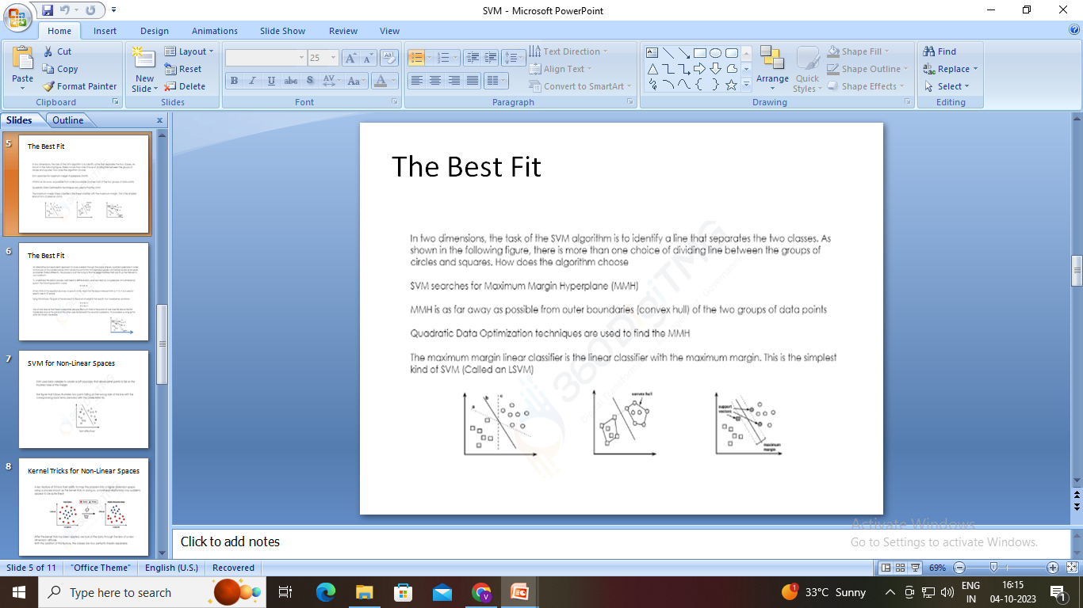
The Best Fit

Slide 9
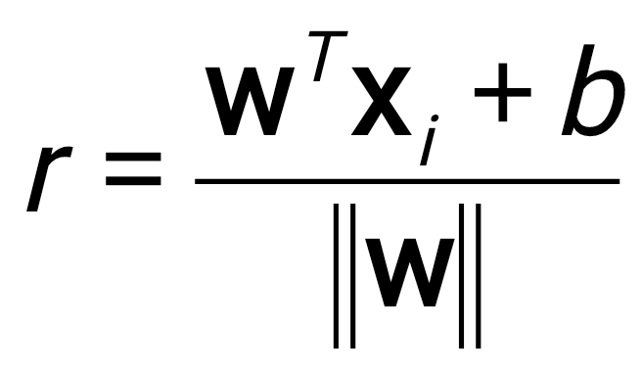
Classification Margin
Distance from example x_{i} to the separator is
Examples closest to the hyperplane are support vectors.
Margin ρ of the separator is the distance between support vectors.
ρ
r
Notes:
‹#›

Slide 10
Maximum Margin Classification
Maximizing the margin is good according to intuition and PAC theory.
Implies that only support vectors matter; other training examples are ignorable.

Slide 11
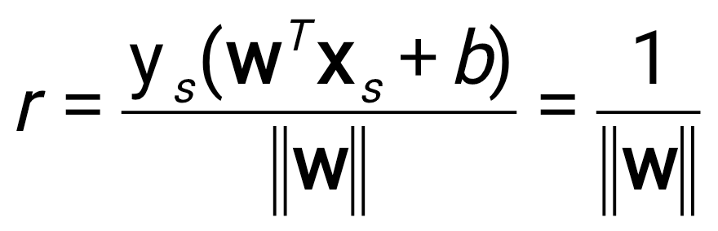
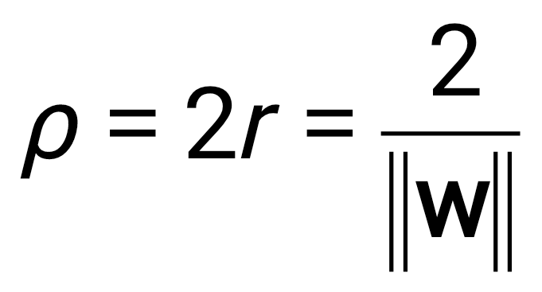
Linear SVM Mathematically
Let training set {(x_{i}, y_{i})}_{i=1..n}, x_{i}∈R^{d}, y_{i} ∈ {-1, 1} be separated by a hyperplane with margin ρ. Then for each training example (x_{i}, y_{i}):
For every support vector x_{s} the above inequality is an equality. After rescaling w and b by ρ/2 in the equality, we obtain that distance between each x_{s} and the hyperplane is
Then the margin can be expressed through (rescaled) w and b as:
w^{T}x_{i} + b ≤ - ρ/2 if y_{i} = -1
w^{T}x_{i} + b ≥ ρ/2 if y_{i} = 1
⇔
y_{i}(w^{T}x_{i} + b) ≥ ρ/2

Slide 12
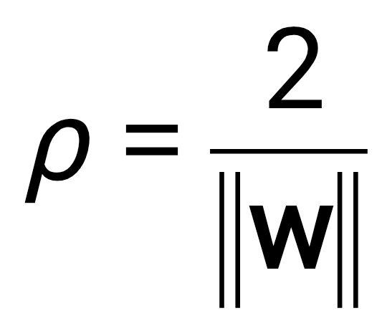
Linear SVMs Mathematically (cont.)
Then we can formulate the quadratic optimization problem:
Which can be reformulated as:
Find w and b such that
is maximized
and for all (x_{i}, y_{i}), i=1..n : y_{i}(w^{T}x_{i} + b) ≥ 1
Find w and b such that
Φ(w) = ||w||²=w^{T}w is minimized
and for all (x_{i}, y_{i}), i=1..n : y_{i} (w^{T}x_{i} + b) ≥ 1

Slide 13
Soft Margin Classification
What if the training set is not linearly separable?
Slack variables ξ_{i} can be added to allow misclassification of difficult or noisy examples, resulting margin called soft.
ξ_{i}
ξ_{i}
SVM is robust for the outliers.

Slide 14
Non-linear SVMs
Datasets that are linearly separable with some noise work out great:
But what are we going to do if the dataset is just too hard?
How about… mapping data to a higher-dimensional space:
0
x
0
x
x²
0
x

Slide 15
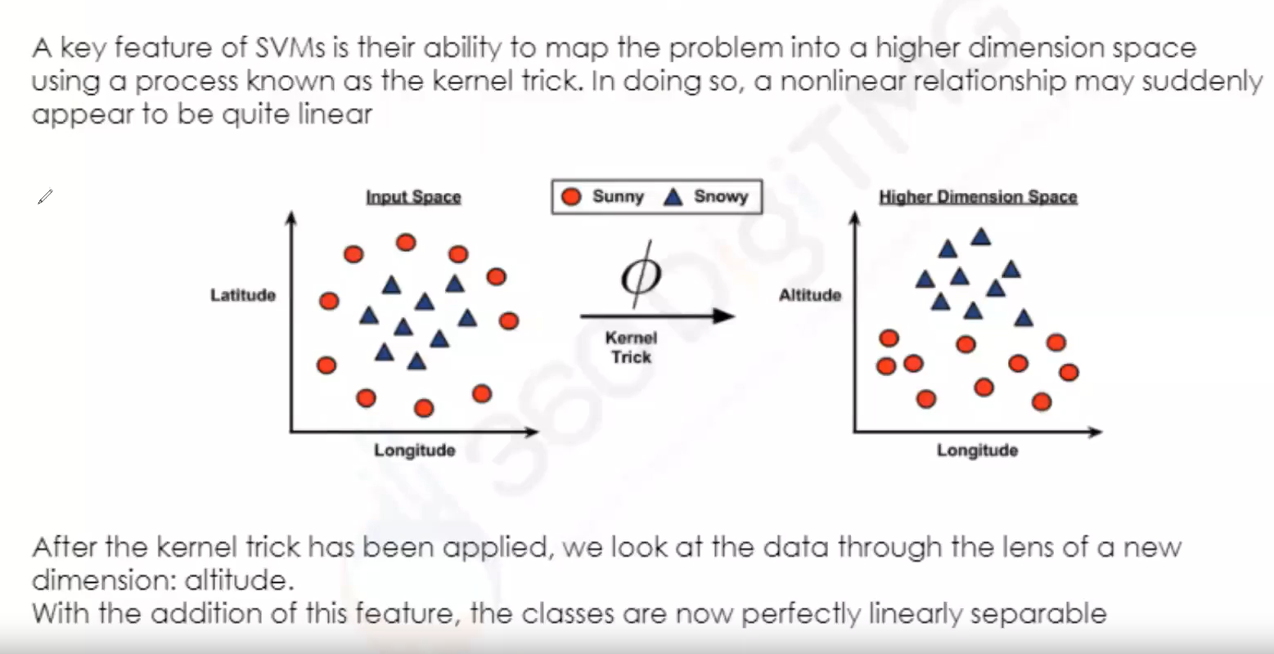
Kernel Tricks for Non-Linear Spaces

Slide 16
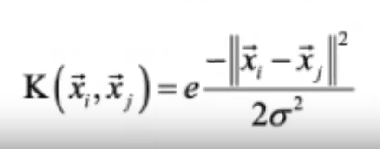
Various Kernel Functions in SVM
The linear kernel does not transform the data at all. Therefore, it can be expressed simply as the dot product of the features:
K(x_{i},x_{j})= x_{i}^{T}x_{j}
The polynomial kernel of degree p adds a simple non-linear transformation of the Data:
Polynomial of power p:
K(x_{i},x_{j})= (1+ x_{i}^{T}x_{j})^{p}
The sigmoid kernel results in a SVM model somewhat analogous to a neural network using a sigmoid activation function. The Greek letters kappa and delta are used as kemel parameters:
K(x_{i},x_{j})= tanh(kxixj - δ)
Gaussian RBF kernel is similar to a RBF (radial basis function) neural network. The RBF kernel performs well on many types of data and is thought to be a reasonable starting point for many learning tasks:

Slide 17
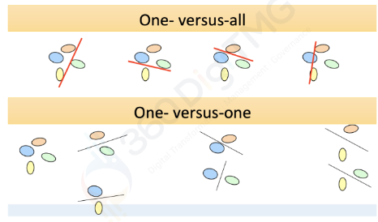
Multi-Class Classification using SVM
The result will be based on a Higher Probability

Slide 18
SVM applications
SVMs were originally proposed by Boser, Guyon and Vapnik in 1992 and gained increasing popularity in late 1990s.
SVMs are currently among the best performers for a number of classification tasks ranging from text to genomic data.
SVMs can be applied to complex data types beyond feature vectors (e.g. graphs, sequences, relational data) by designing kernel functions for such data.
SVM techniques have been extended to a number of tasks such as Classification, regression, principal component analysis etc.
Tuning SVMs remains a black art: selecting a specific kernel and parameters is usually done in a try-and-see manner.

Slide 19
ASSOCIATION RULES
Notes:
‹#›

Slide 20
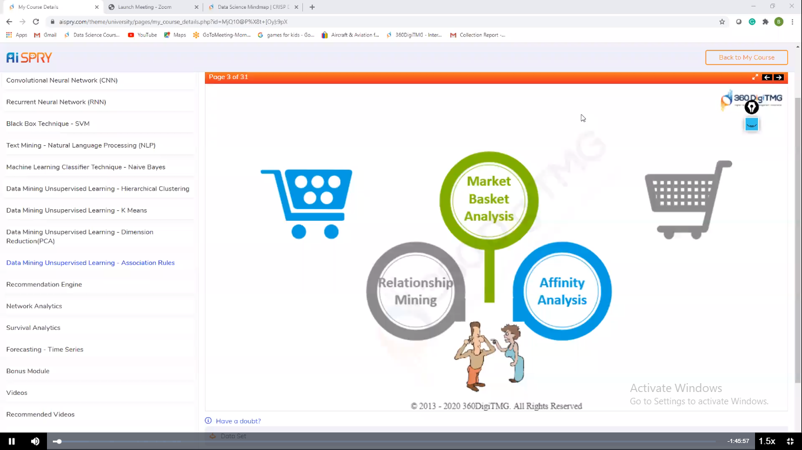
Market Basket Analysis

Slide 21
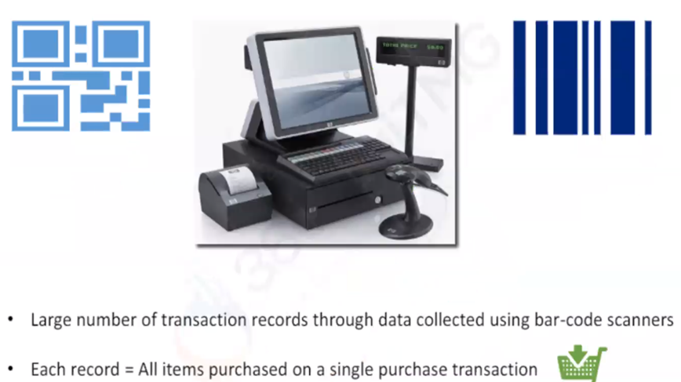
Market Basket Analysis

Slide 22
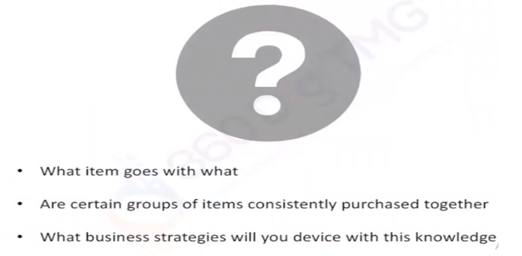
Association Rules Intuition

Slide 23
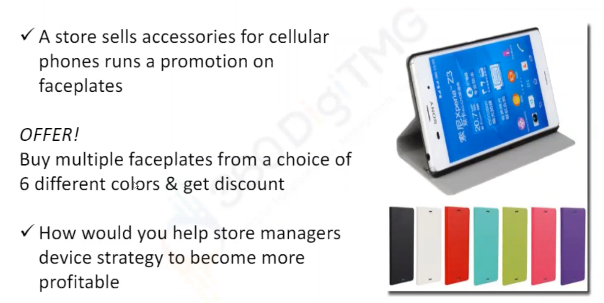
Association Rules Mobile Faceplates

Slide 24
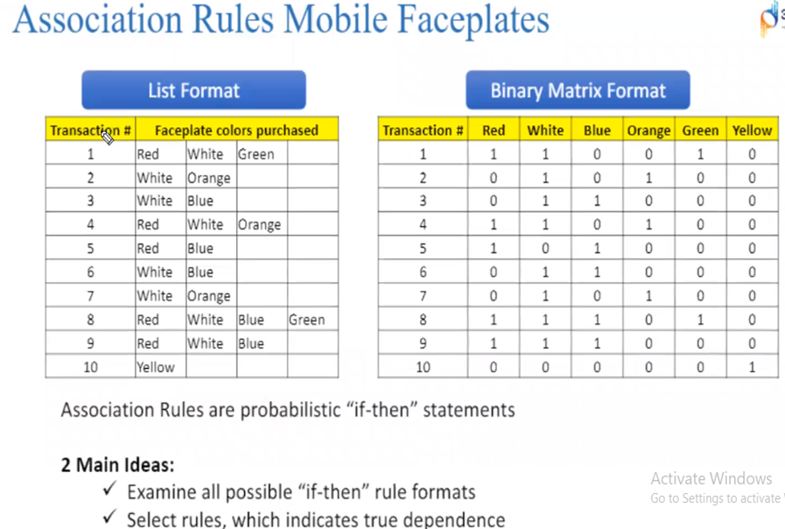

Slide 25
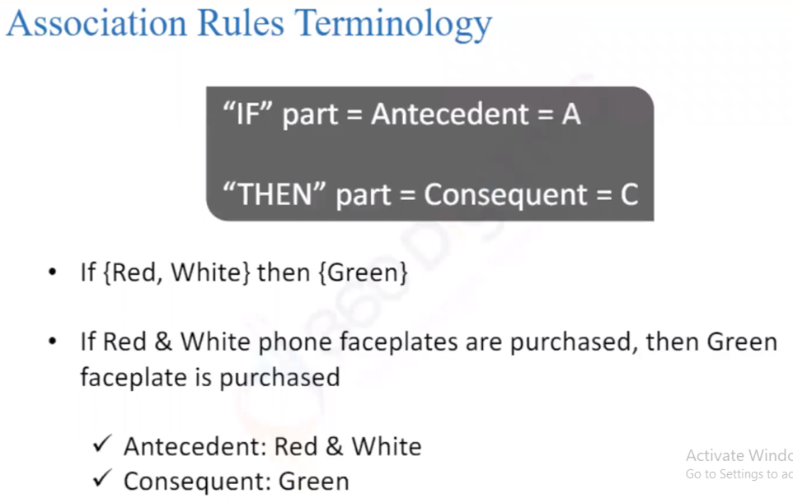
Association Rules Terminology

Slide 26
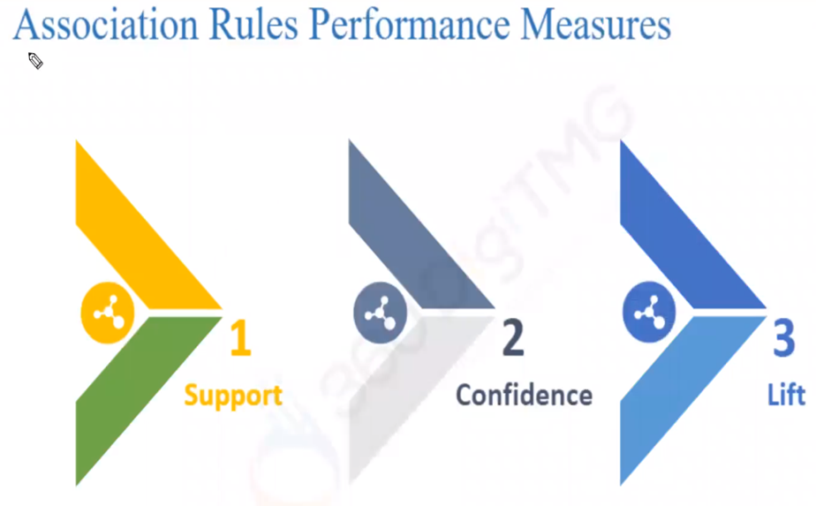
Association Rules Performance Measures

Slide 27
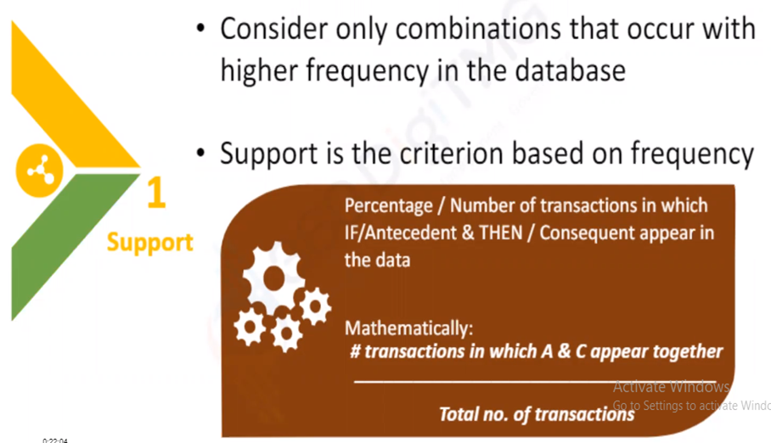
Association Rule - Support

Slide 28
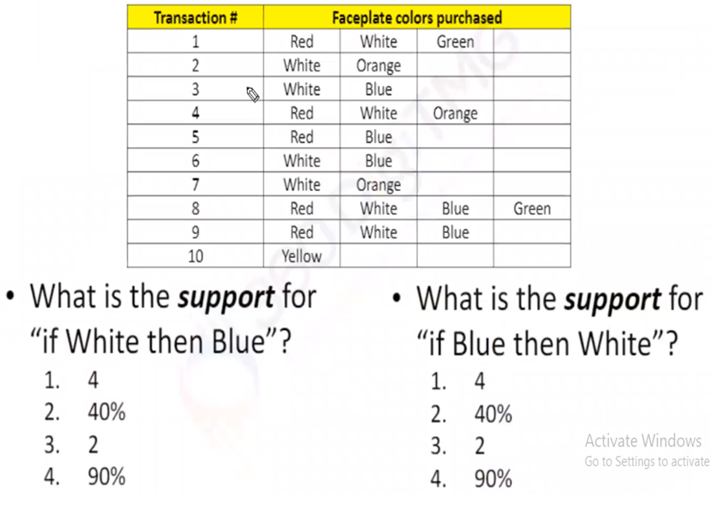
Support Calculation

Slide 29
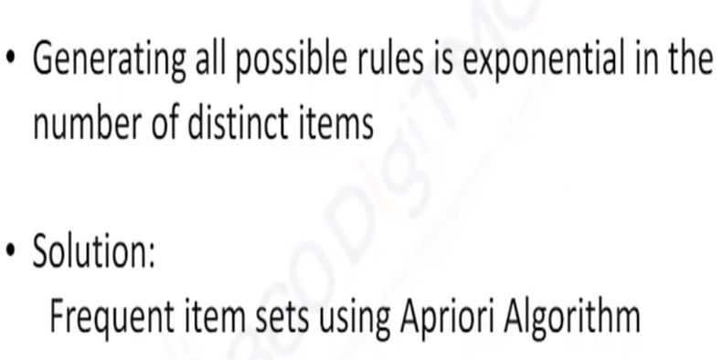
Support Drawbacks

Slide 30
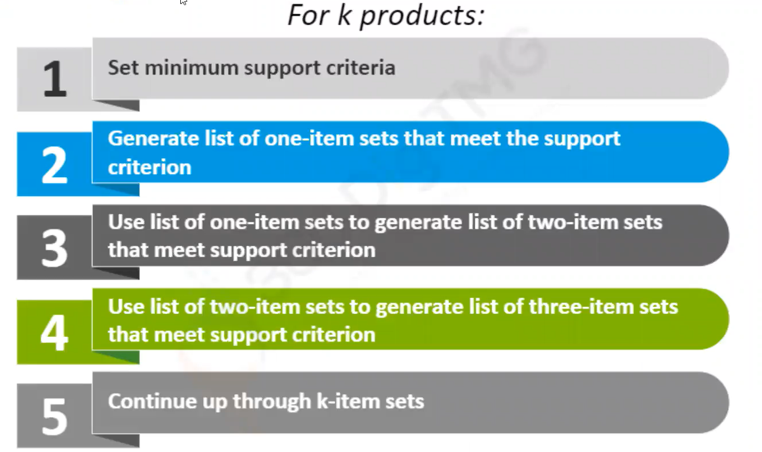
Apriori Algorithm

Slide 31
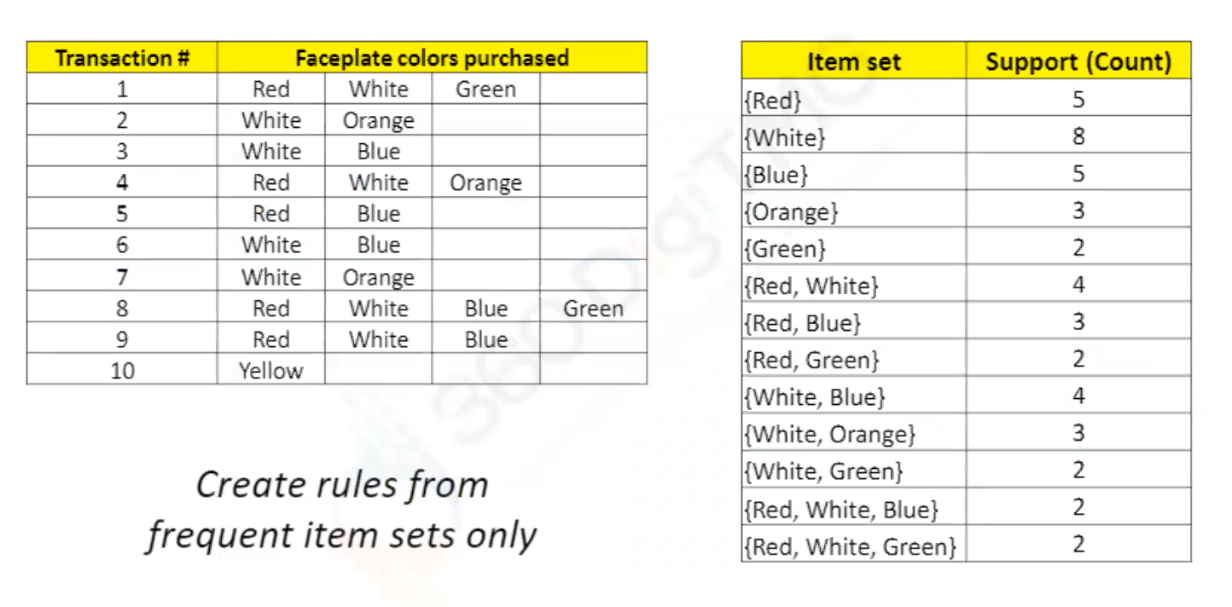
Support Min Criterion=2

Slide 32
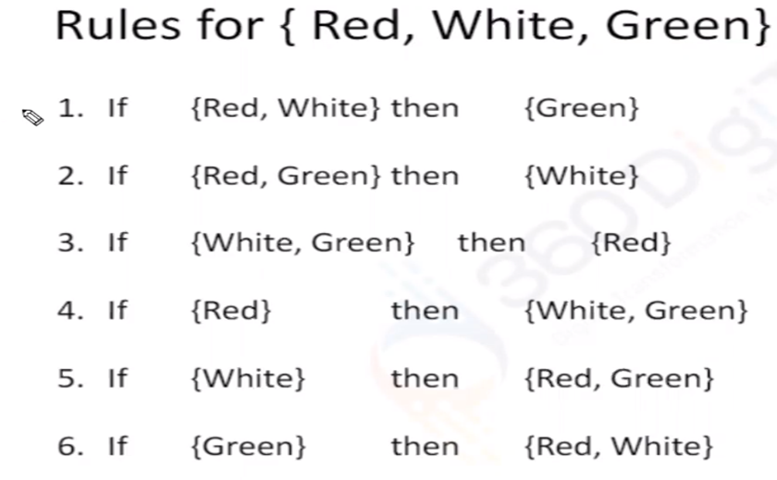
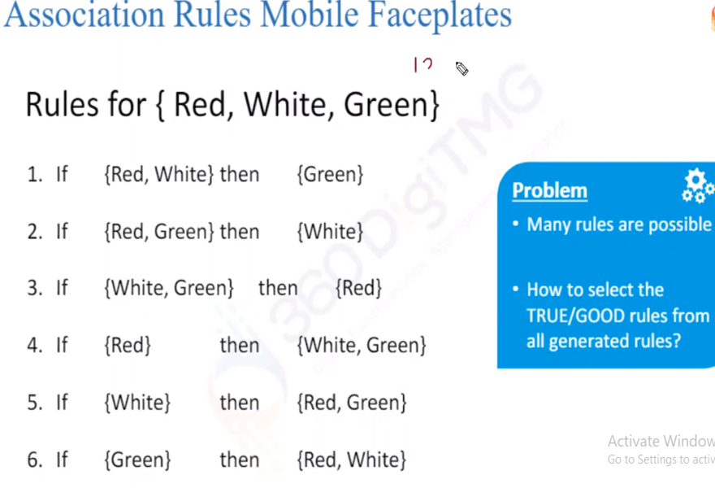
Association Rules Mobile Faceplates
n items = n! Rules

Slide 33
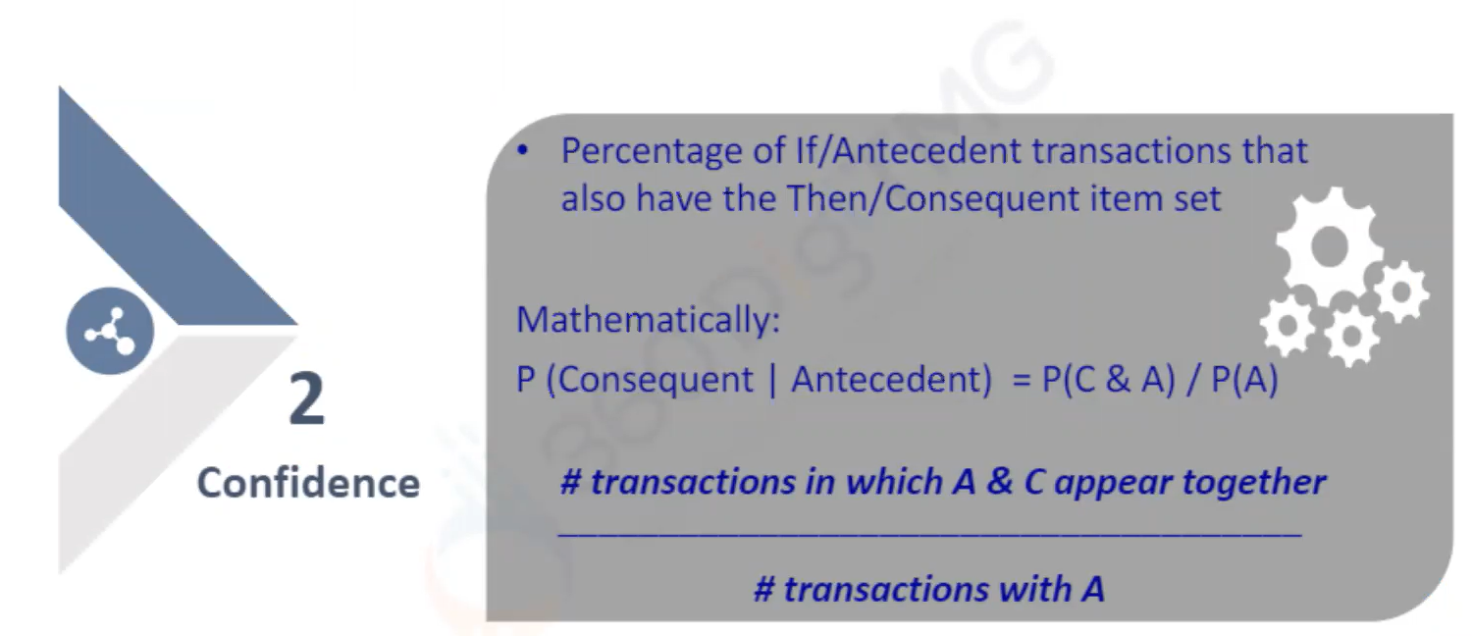
Association Rules - Confidence

Slide 34
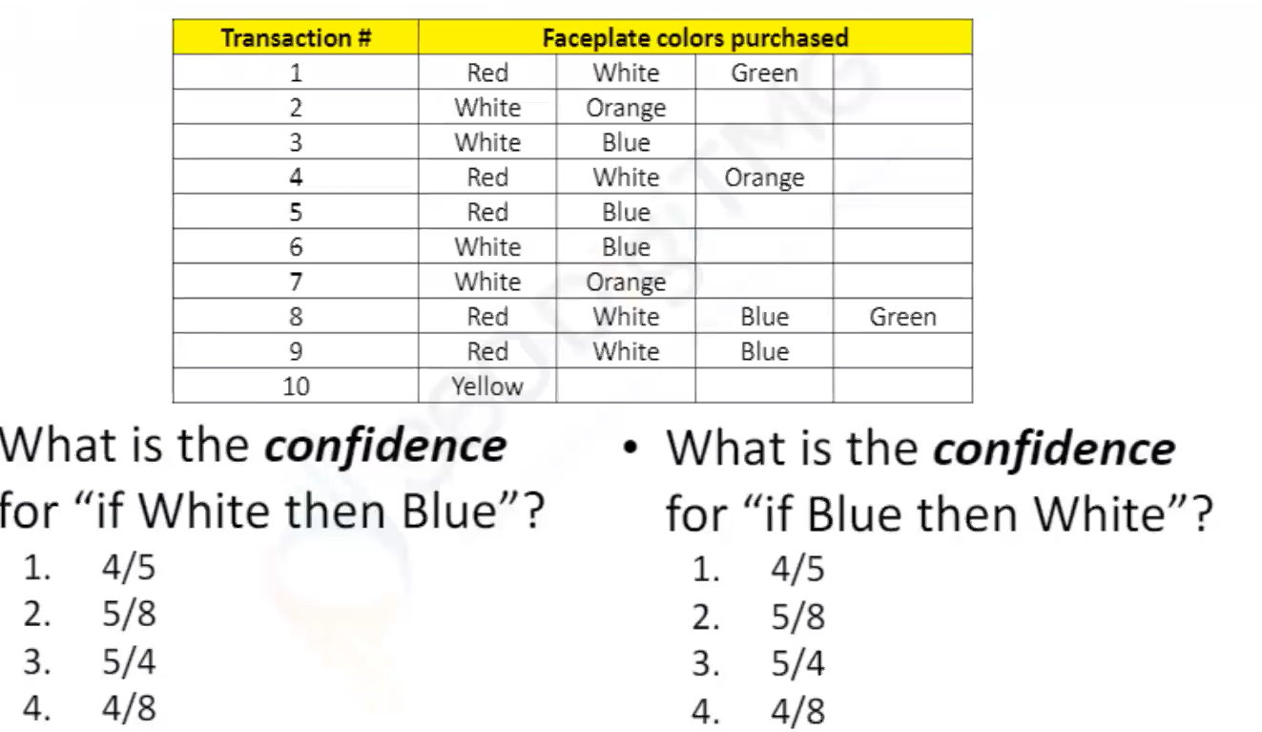
Confidence Calculation

Slide 35
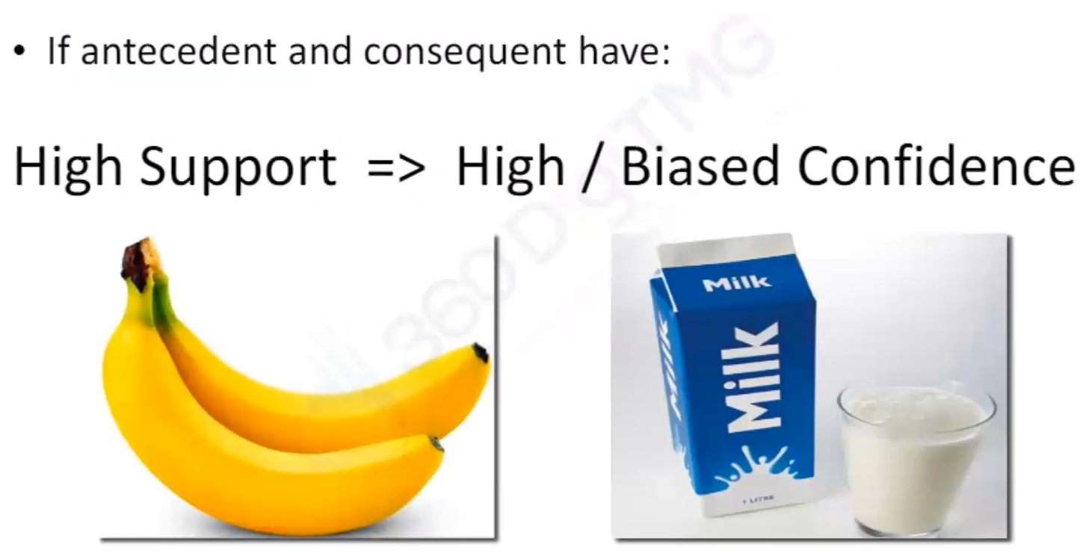
Confidence Weakness

Slide 36
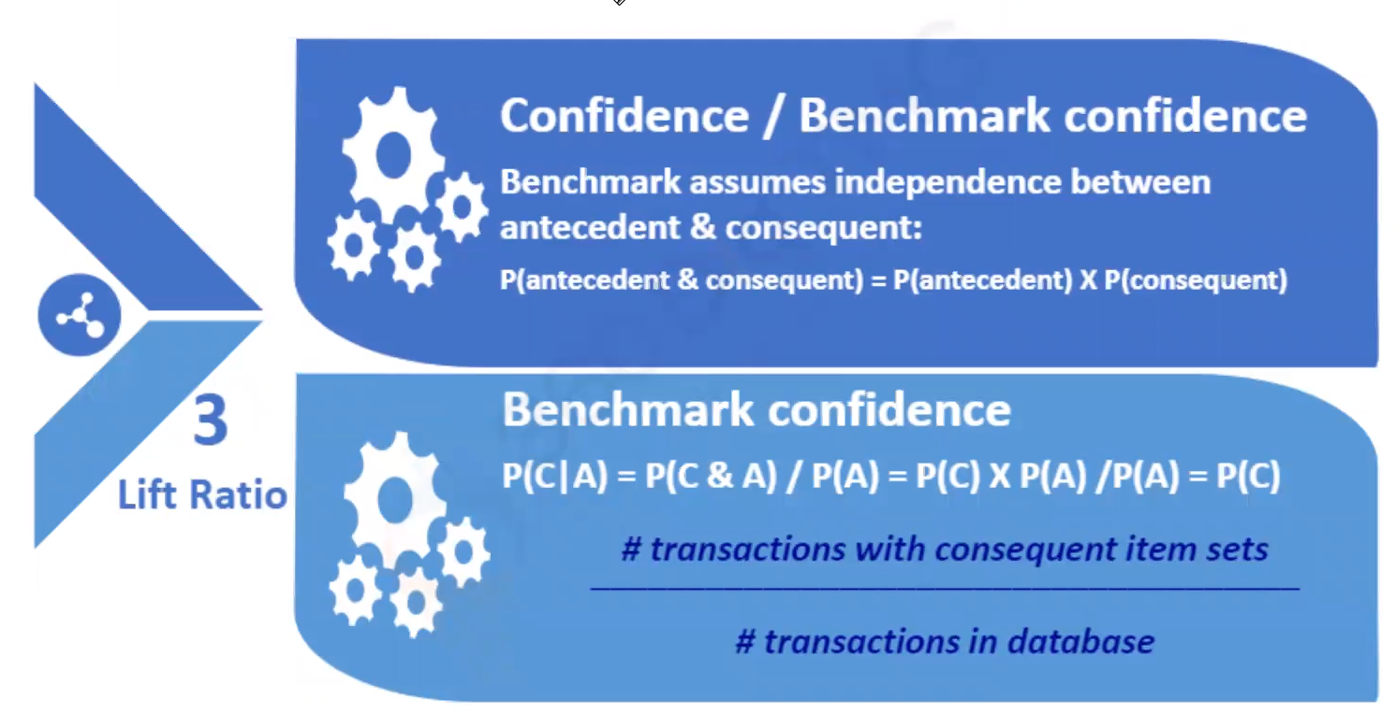
Association Rules- Lift Ratio

Slide 37
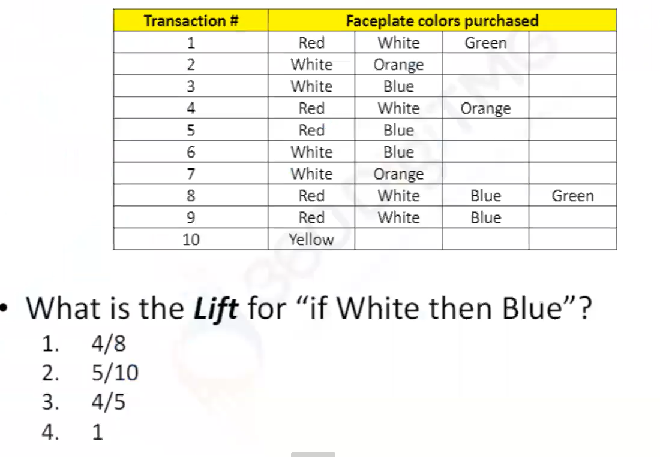
Lift Ratio - Calculation

Slide 38
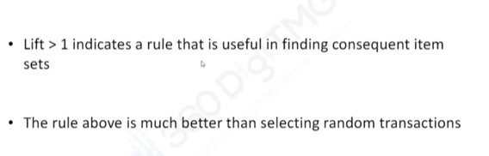
Lift Interpretation

Slide 39
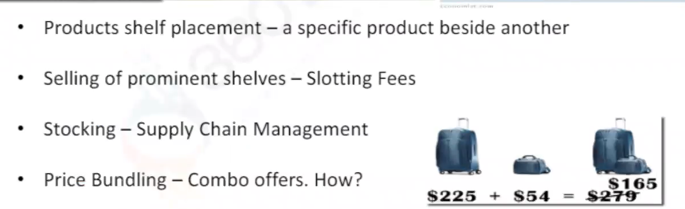
Association Rules Applications

